Slide 1

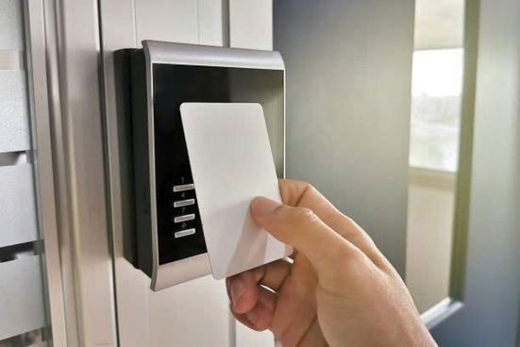
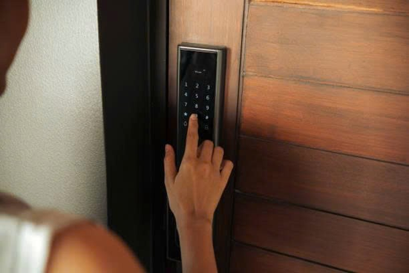

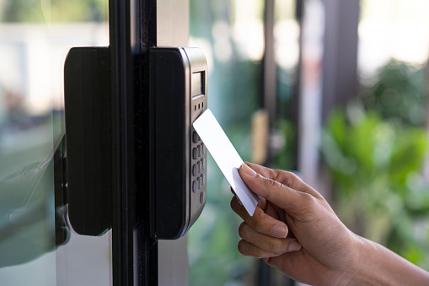
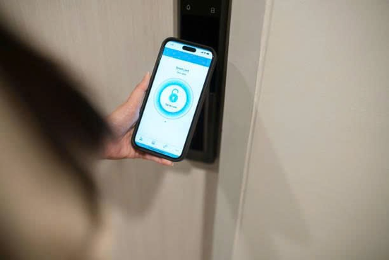
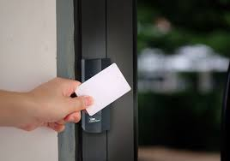
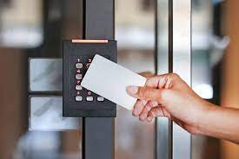
SMART DOOR LOCK
TECHNOLOGY
GROUP 2

Slide 2
SMART DOOR LOCK
TECHNOLOGY
GROUP 2
SE181860 Lê Phạm Hoài Bảo SE192755 Vũ Minh Quang
SE191034 Nguyễn Minh Thành SE191044 Hoàng Bảo Thạch

Slide 3

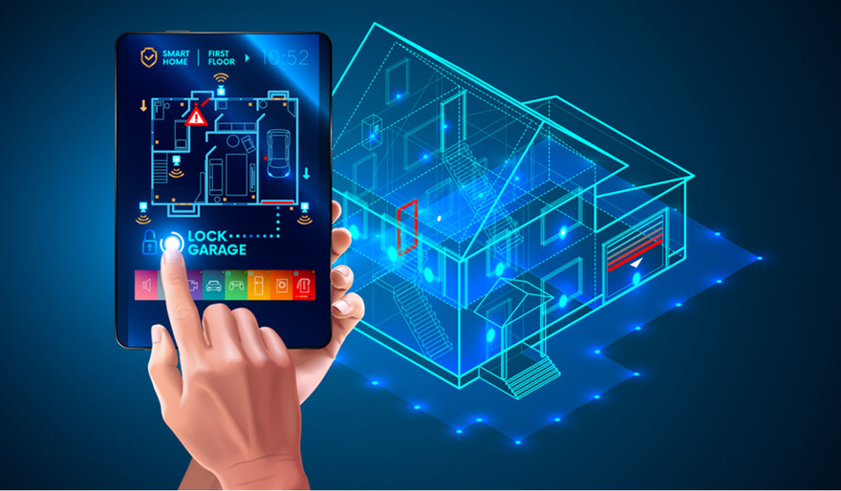
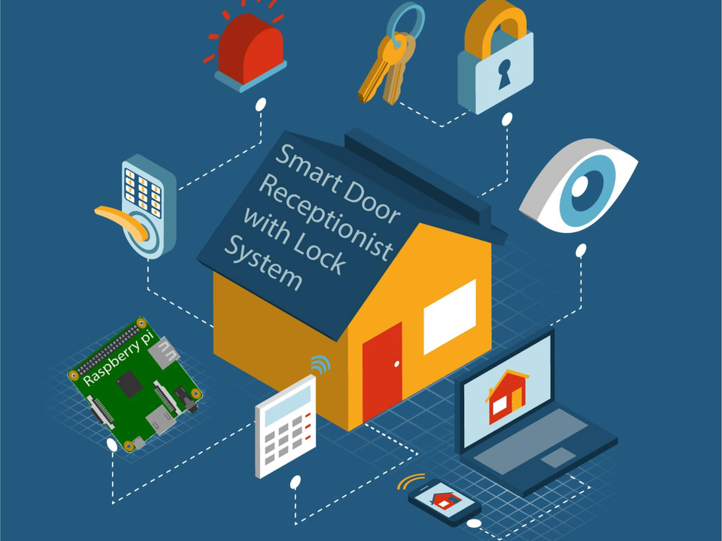
ABSTRACT
🎯 Objective:
Enhance home security and user convenience.
🧠 Core Controller:
Arduino Uno processes inputs, handles authentication, and controls devices.
🔑 Access Methods:
Ultrasonic Sensor (HC-SR04) – Detects presence to activate system
Keypad (4x4) – Secure PIN entry
RFID Reader (RC522) – Tap MIFARE cards/key fobs
Bluetooth (HC-05) – Unlock via smartphone app

Slide 4
ABSTRACT
🔒 Lock Mechanism:
Electromagnetic lock activated by a relay after successful authentication.
💻 Software:
Modular code with libraries: Keypad.h, MFRC522.h, SoftwareSerial.h
⚙️ Performance:
Reliable operation, response time < 1s across all modes.
🚀 Scalability:
Ready for upgrades like biometric access, 2FA, or cloud-based user management.
✅ Conclusion:
Secure, flexible, and user-friendly — ideal for modern smart homes.

Slide 5


INTRODUCTION
❓ Why Do We Need a Smart Lock?
🔐 Traditional locks are vulnerable to physical break-ins.
🧠 Cyber threats are evolving — modern homes need smarter protection.
🏠 As smart homes become common, secure and convenient access control is essential.
💡 Why This Topic?
⚙️ Technology is advancing rapidly — especially in IoT and embedded systems.
🔒 Combines security, automation, and user convenience.
📱 Allows users to monitor and control access remotely — a growing demand in modern lifestyles.

Slide 6
INTRODUCTION
🚀 Project Highlights
🔑 Multi-modal unlocking: RFID card, keypad PIN, and Bluetooth app.
🧍 Human presence detection using an ultrasonic sensor (HC-SR04).
🌐 Real-time monitoring via Wi-Fi (NodeMCU) and ThingSpeak IoT platform.
⚡ Fast authentication, average response time < 1s.
🔧 Modular design, ready for future upgrades like biometrics or 2FA.
✅ Balances security, usability, and scalability — ideal for smart home systems.

Slide 7
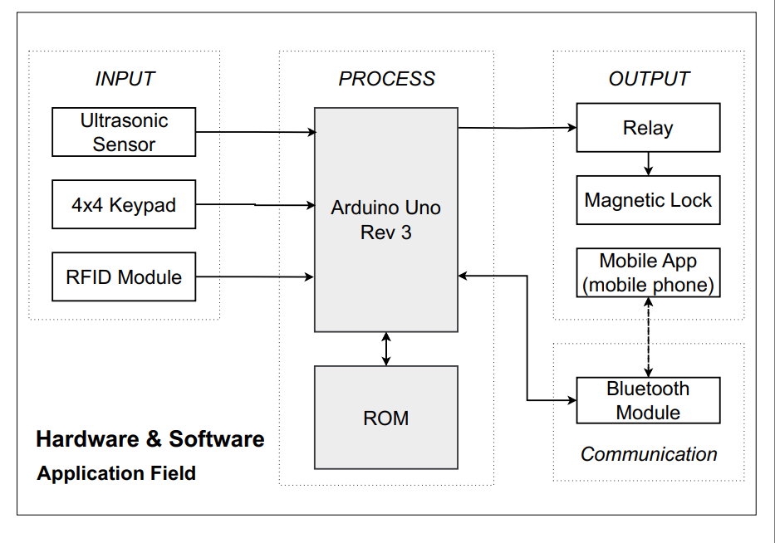
BLOCK DIAGRAM

Slide 8
BLOCK DIAGRAM
System Architecture Overview
The smart door lock system is divided into 4 main functional blocks:
🔹 Input
🔹 Processing
🔹 Output
🔹 Communication
1. Input Block
👣 Ultrasonic Sensor (HC-SR04):
Detects human presence near the door (~<100 cm) → triggers the system.
🔢 Keypad (4x4):
Allows users to enter a PIN.
📶 RFID Reader (MFRC522):
Scans contactless cards/tags, sends UID via SPI.
2. Processing Block
🧩 Controller: Arduino Uno Rev3
📥 Reads and compares RFID/PIN input with stored credentials (EEPROM/flash).
🔁 Executes conditional logic to allow or deny access.

Slide 9
BLOCK DIAGRAM
3. Output Block
🔒 Relay Module + Electromagnetic Lock
Unlocks door briefly if authentication succeeds.
🔁 Auto re-lock after timeout.
🔴 LEDs / Buzzer: Feedback on access status.
4. Communication Block
📱 Bluetooth Module (HC-05)
Receives remote unlock commands.
Sends real-time status to smartphone.
Enhances convenience & user control.
System Benefits
⚙️ Modular design → Easy maintenance & upgrades
🚀 Scalable: Add fingerprint, camera, or cloud features later
🏠 Suitable for homes & offices (balance of security + convenience)

Slide 10

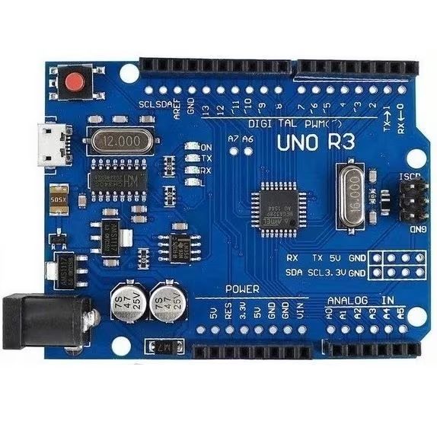
COMPONENTS AND PERIPHERAL DEVICES
ARDUINO UNO
💻 Microcontroller: Based on ATmega328P, widely used in IoT projects.
⚙️ Digital I/O: 14 pins (D0–D13), with PWM support on D3, D5, D6, D9, D10, D11.
🔁 Communication:
UART on D0 (RX) and D1 (TX) – avoid using with Bluetooth to prevent conflicts.
SPI on D10–D13 for device communication.
📈 Analog Input: 6 pins (A0–A5) for analog sensors.
🔌 Power Supply:
5V and 3.3V regulated outputs
VIN pin supports 7–12V external input
GND for grounding
🧑‍💻 Programming:
Uses Arduino IDE
Simple syntax and rich library support
Suitable for both beginners and experts

Slide 11
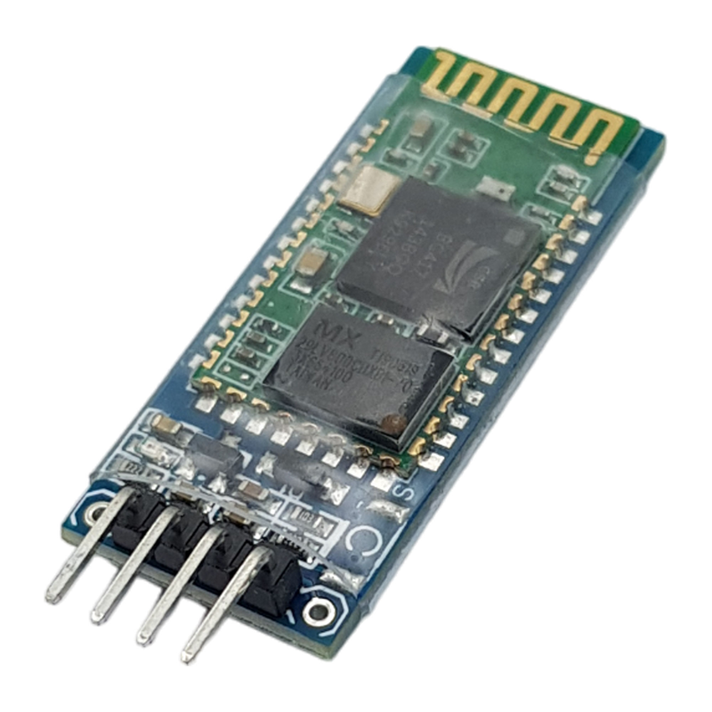
COMPONENTS AND PERIPHERAL DEVICES
HC-05 BLUETOOTH MODULE
🔗 Wireless Communication: Enables serial data transfer between microcontrollers (e.g., Arduino) and Bluetooth devices (phones, laptops).
🧭 Dual Mode Support: Operates in both Master and Slave modes — flexible for IoT systems.
💬 UART Interface: Communicates via TX/RX, default baud rate 9600 bps (configurable via AT commands).
📶 Bluetooth Standard: Based on Bluetooth 2.0 + EDR, with a range of up to 10 meters in open space.
⚡ Voltage Compatibility: Built-in regulator and level shifter allow safe use with 5V Arduino boards, even though the chip runs at 3.3V.
⚙️ Customizable: Supports settings like device name, pairing password, and baud rate for personalized use.
📱 Project Role: Used for remote door unlocking via smartphone, improving user convenience without needing Wi-Fi or Internet.

Slide 12
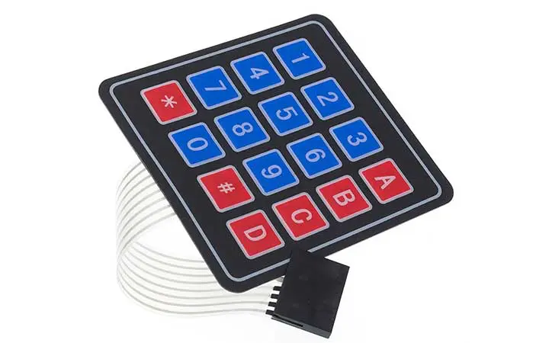
COMPONENTS AND PERIPHERAL DEVICES
KEYPAD 4X4 MATRIX – 16-BUTTON
🔢 Structure:
4 rows (R1–R4), 4 columns (C1–C4)
8 digital pins connected to Arduino
⚙️ Working Principle:
Arduino scans row-column to detect key press
🔁 Communication:
Digital signals
Supported by Keypad.h library
🔌 Power Supply:
Operates at 5V
No extra components required
🧑‍💻 Programming:
Compatible with Arduino IDE
Easy to use in smart lock systems

Slide 13
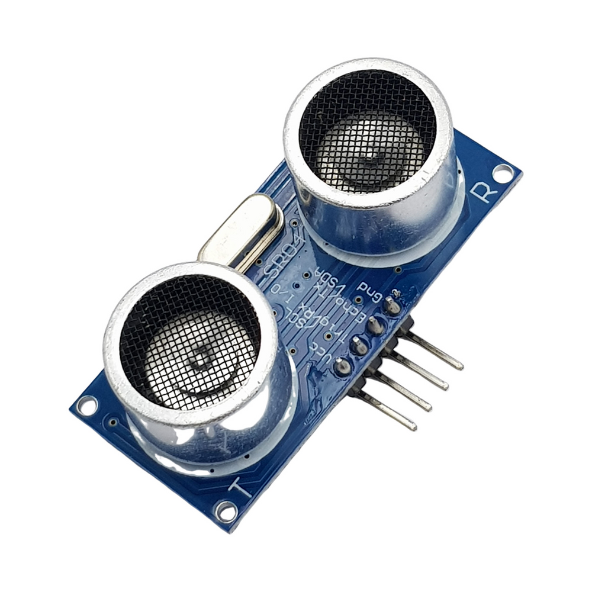
COMPONENTS AND PERIPHERAL DEVICES
HC-SR04 – ULTRASONIC DISTANCE SENSO
📏 Measurement Range: 2–400 cm, accuracy ±3 mm
⚙️ Digital I/O:
Trig: Output signal (send ultrasonic pulse)
Echo: Input signal (receive reflected pulse)
🔁 Communication:
Digital signal interface
Controlled via digitalWrite() (Trig) & pulseIn() (Echo)
🔌 Power Supply:
VCC: 5V DC
GND: Ground
🧑‍💻 Programming:
Works with Arduino IDE
No special library required
Easy integration with smart door or motion detection systems

Slide 14
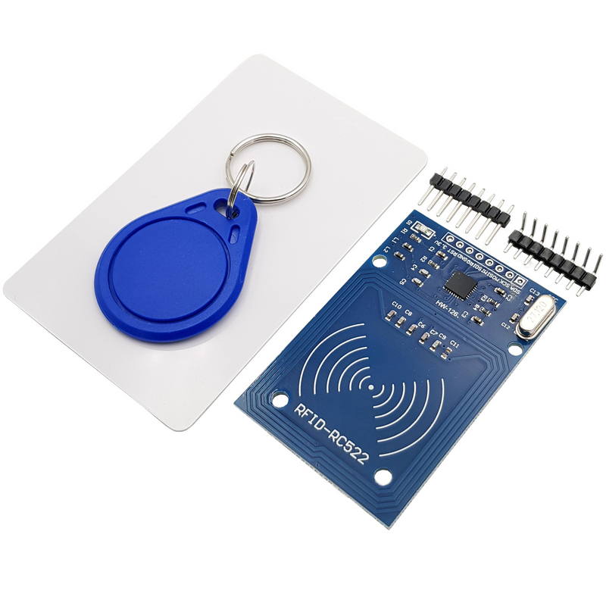
COMPONENTS AND PERIPHERAL DEVICES
RC522 – 13.56 MHZ CONTACTLESS
CARD READER
💳 Card Type: Supports MIFARE cards/tags
🔁 Communication:
SPI: SDA, SCK, MOSI, MISO
Uses MFRC522.h library
⚙️ Pins:
7 pins: SDA, SCK, MOSI, MISO, RST, VCC (3.3V), GND
🔌 Power Supply:
3.3V only (⚠️ avoid 5V)
🧑‍💻 Programming:
Simple UID reading with Arduino IDE
Commonly used for RFID-based door access

Slide 15
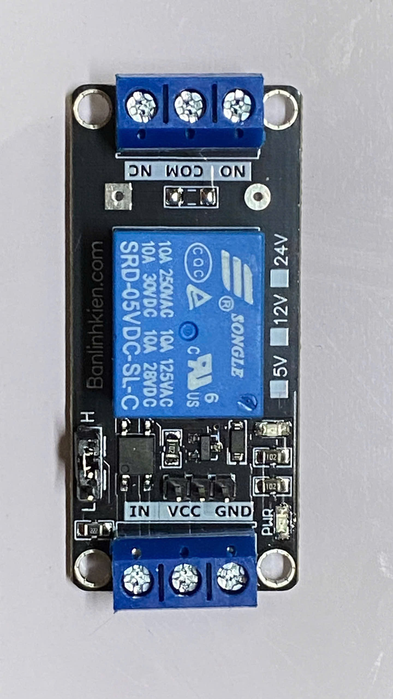
COMPONENTS AND PERIPHERAL DEVICES
CHANNEL RELAY
⚙️ Control Pins:
IN: Signal from Arduino
VCC: 5V
GND: Ground
🔁 Output Terminals:
COM (Common)
NO (Normally Open)
NC (Normally Closed)
🧑‍💻 Programming:
Controlled with digitalWrite()
No library needed
⚡ Usage:
Switches 12V power to magnetic lock
Opto-isolated for protection

Slide 16
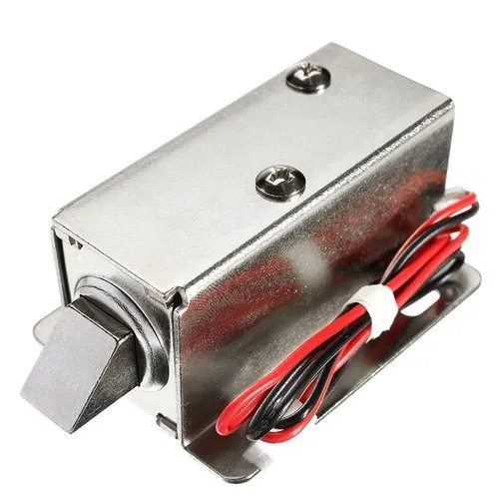
COMPONENTS AND PERIPHERAL DEVICES
MAGNETIC LOCK 12V
⚡ Operating Principle:
Powered (12V DC): Electromagnet holds metal plate → door locked
Unpowered: Lock releases → door opens
Fail-safe: Always locked when powered, auto-unlocks on power loss
🔌 Power Supply:
Requires 12V DC, current draw 0.5–1A
Needs separate power supply (not powered by Arduino directly)
⚙️ Control Method:
Controlled via Relay Module
Arduino switches relay to cut or restore 12V power
🧑‍💻 Integration:
Used in smart door systems
Unlocks after successful RFID scan or correct keypad input
🛡️ Safety Note:
Suitable for fire safety systems – unlocks on power failure
Ensure proper heat dissipation and stable power source

Slide 17
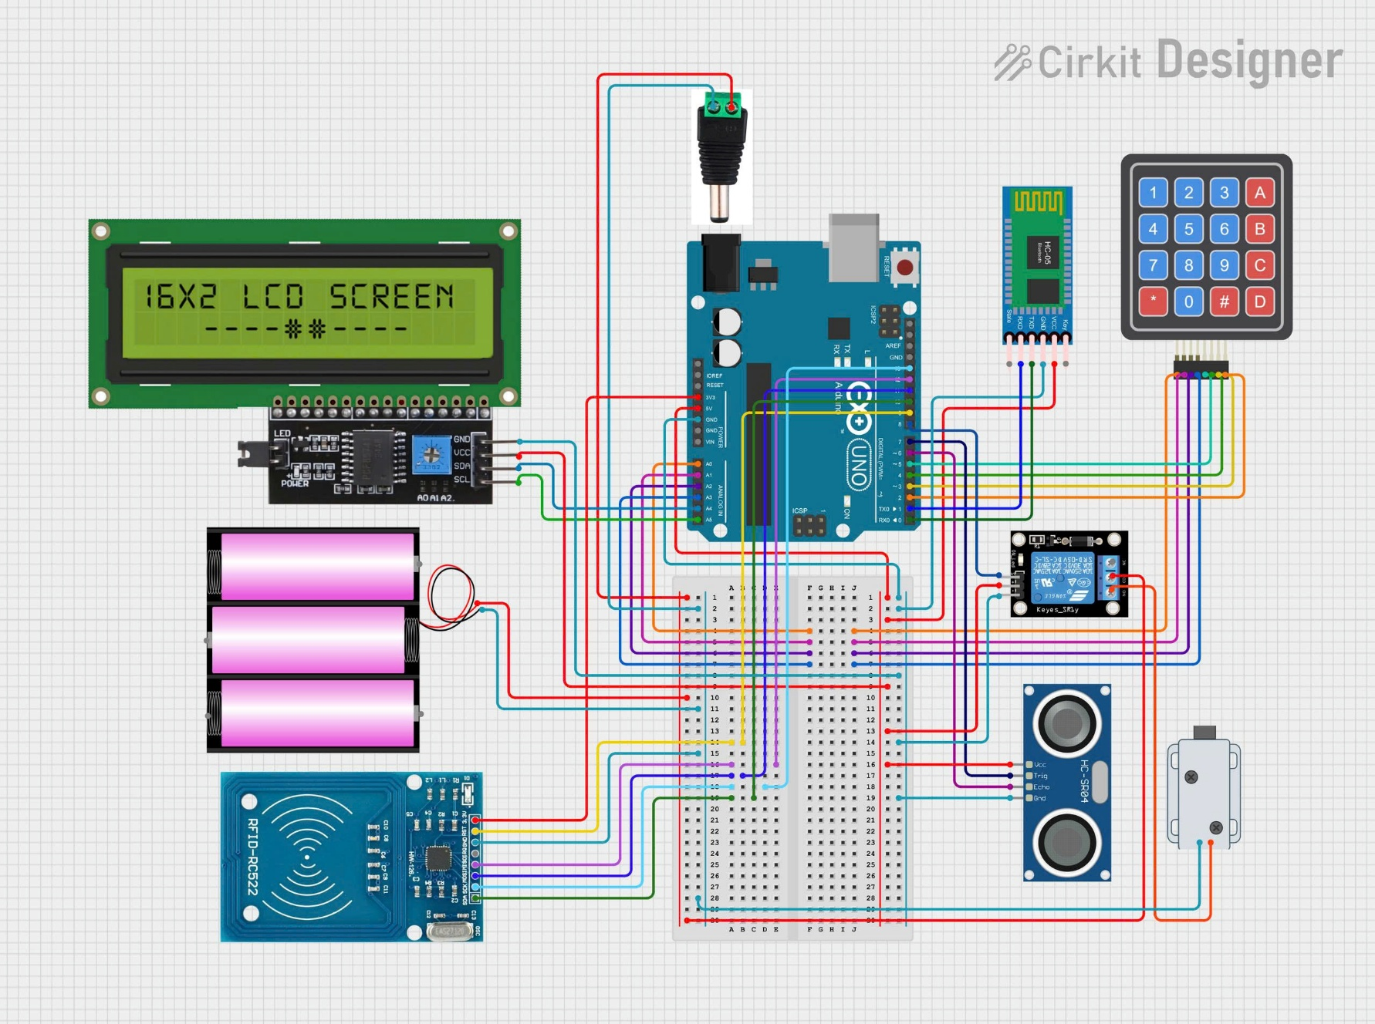
COMPONENTS AND PERIPHERAL DEVICES
CIRCUIT DIAGRAM
🔧 Controller
Arduino Uno serves as the central controller, managing all system operations in the smart door lock.
🔐 Authentication Methods
4x4 Keypad: For PIN code entry.
RFID RC522: For contactless card authentication.
Bluetooth HC-05: Enables smartphone-based unlocking.
👁️‍🗨️ Presence Detection
HC-SR04 Ultrasonic Sensor: Detects a person within close range (around 0.5 m) to activate the system only when needed.
🔋 Power Supply
9V Battery with Power Module: Provides stable 5V and 3.3V output to protect all components.

Slide 18
COMPONENTS AND PERIPHERAL DEVICES
CIRCUIT DIAGRAM
🔊 User Feedback
🔔 Buzzer & LEDs: Provide audio and visual feedback.
💬 16x2 I2C LCD Display: Shows real-time status such as “Access Granted” or “Wrong PIN”.
🔒 Lock Control
⚡ Relay Module: Controls an electromagnetic lock or servo motor based on authentication results.
🧩 Prototyping Layout
🛠️ Breadboard Setup: Neatly connects all modules for easy debugging and expansion.
🎨 Color-coded Wiring: Clear separation of VCC, GND, and signal lines for better organization.
🌐 Expandability
☁️ Optional Add-ons: Supports upgrades with Wi-Fi modules (e.g., ESP8266) for cloud-based control and IoT integration.

Slide 19
SOFTWARE PROGRAMMING

Slide 20
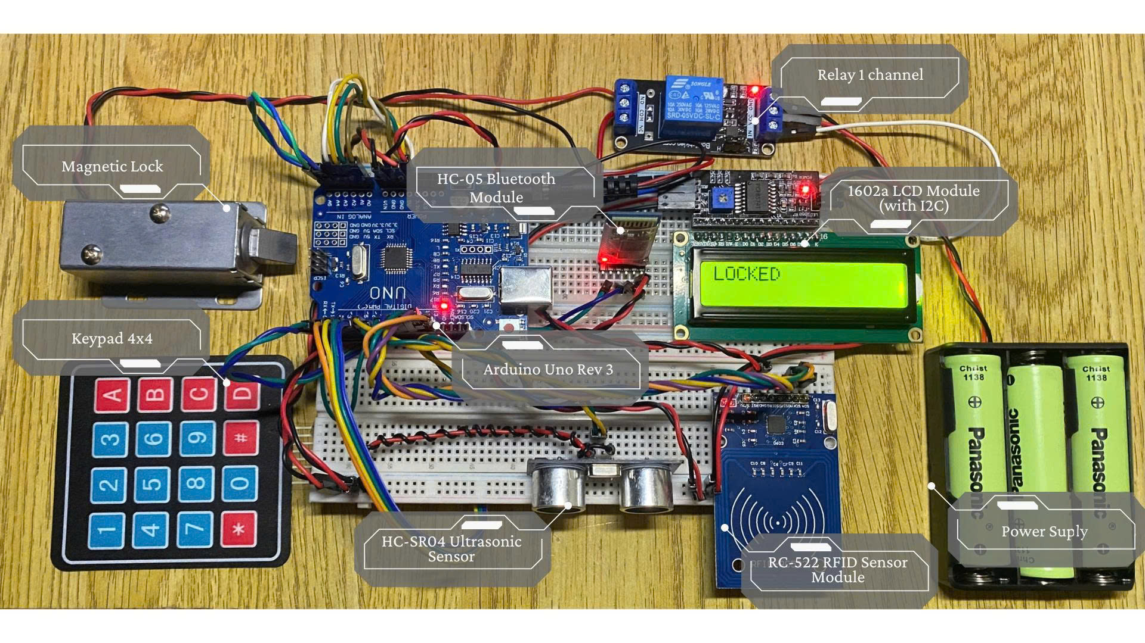
SOFTWARE PROGRAMMING
🔧 1. Central Microcontroller: Arduino Uno R3
Serves as the main controller of the entire system.
Manages sensor input, user authentication, and lock actuation.
Interfaces with peripherals via UART, SPI, and I2C protocols.
Powered through USB or external 12,6V adapter.
👣 2. Ultrasonic Sensor (HC-SR04) – Presence Detection
Connected via D6 (ECHO) and D7 (TRIG).
Continuously measures distance to detect the presence of a person.
Activates the LCD screen when someone is within 50 cm, reducing unnecessary display usage and saving energy.
🔐 3. Relay Module – Lock Control
Connected to D8, acts as an electronic switch.
Controls the electromagnetic door lock.
Unlocks the door for 5 seconds upon successful authentication, then re-locks automatically for security.

Slide 21
SOFTWARE PROGRAMMING
🔢 4. 4x4 Keypad – Password Entry
Connected to D2–D5 (columns) and A0–A3 (rows).
Uses Keypad.h library for efficient scanning and input.
Accepts a 6-digit numerical password.
Validates input and provides feedback via the LCD.
📡 5. RFID Module (MFRC522) – Contactless Authentication
Communicates via SPI interface:
MOSI: D11, MISO: D12, SCK: D13, SS: D10, RST: D9
Reads 13.56 MHz RFID card UIDs.
Authenticates users by comparing card UIDs with stored values in EEPROM.
Supports up to 4 RFID users, each with an 8-byte UID.

Slide 22
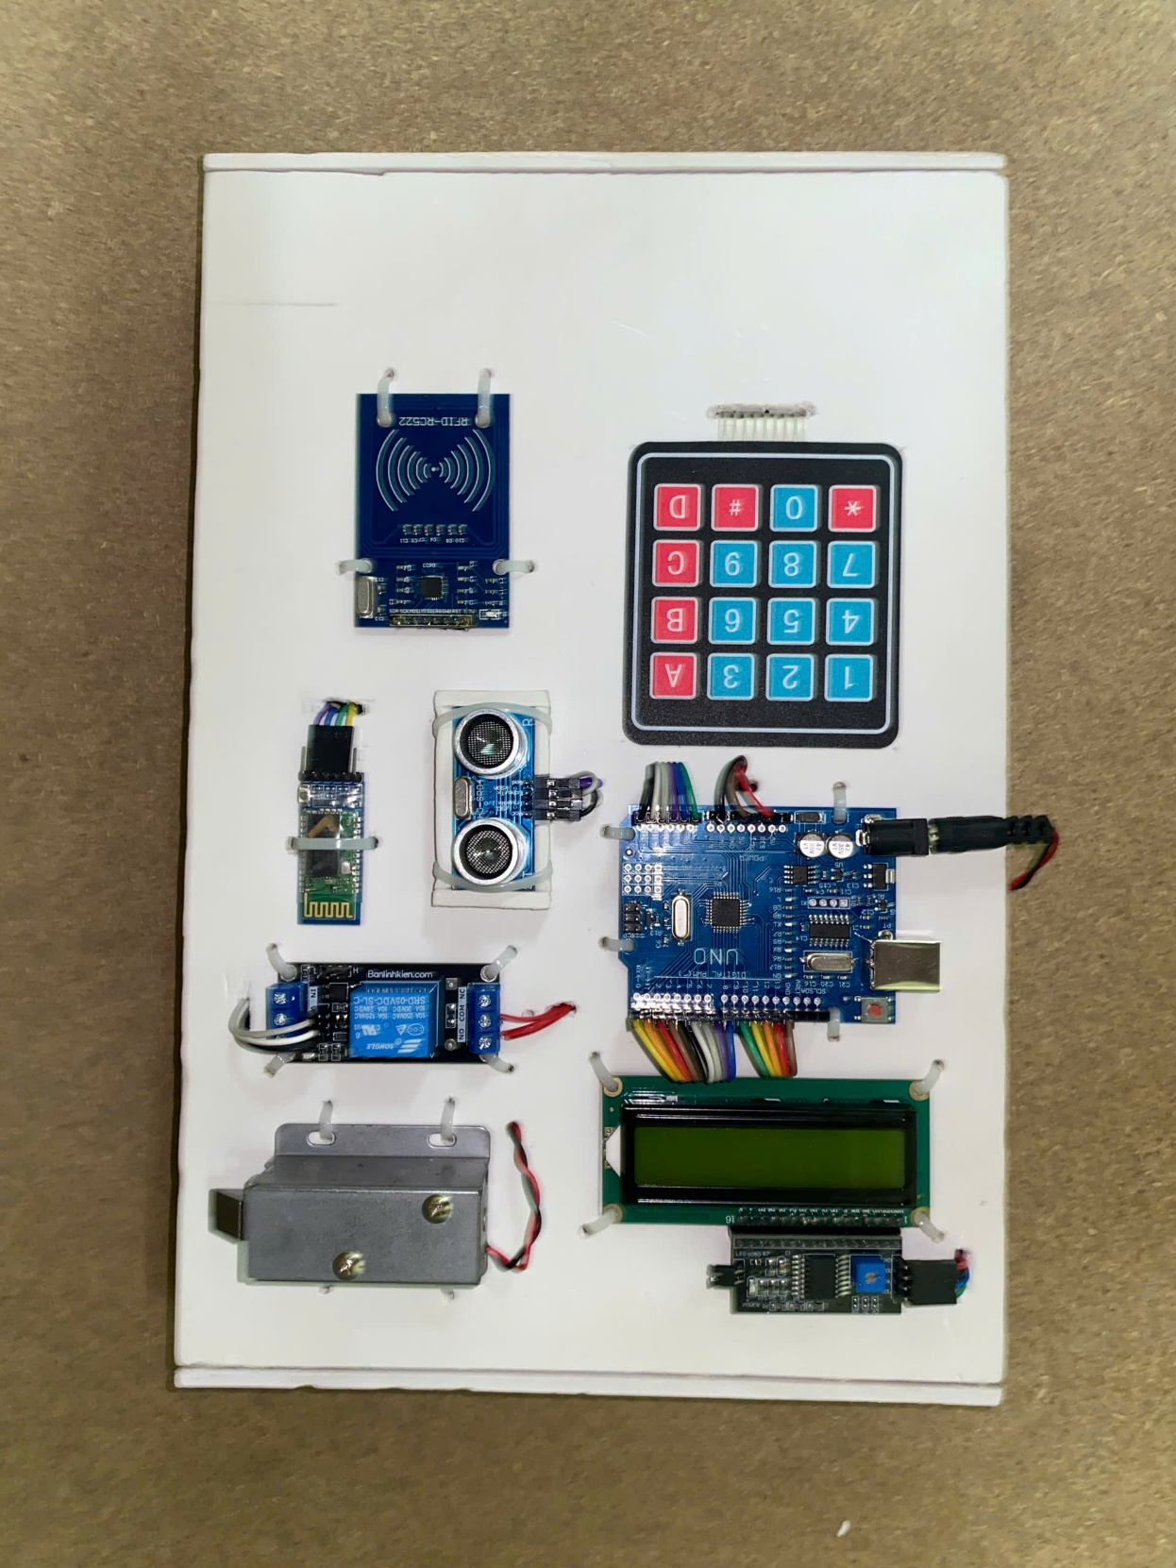
SOFTWARE PROGRAMMING
📲 6. Bluetooth Module (HC-05) – Remote Control
Connected via UART:
TX → D1, RX → D0
Allows control from a mobile device using a Bluetooth terminal app.
Supports commands like:
OPEN – unlocks door remotely
SETPASS – sets a new password
SETCARD – registers new RFID card
📺 7. LCD 16x2 (I2C) – User Feedback
I2C interface via:
SDA: A4, SCL: A5
Displays system messages such as:
"Enter Password", "Access Granted", "Wrong Password", "Card Saved"
Enhances user interaction by providing real-time feedback.

Slide 23
SOFTWARE PROGRAMMING
💾 8. EEPROM – Data Storage
Built-in EEPROM used to store:
Password at address 0
RFID UIDs from address 10 onward
Retains data even when the Arduino is powered off or reset.
Ensures system remembers valid users across reboots.
🚀 9. Scalability & Expansion
Designed to be modular and extendable.
Possible future enhancements:
Fingerprint sensor
Internet connectivity using ESP8266 or ESP32
OLED display for improved visuals
Buzzer for sound alerts
Logging and monitoring via SD card

Slide 24
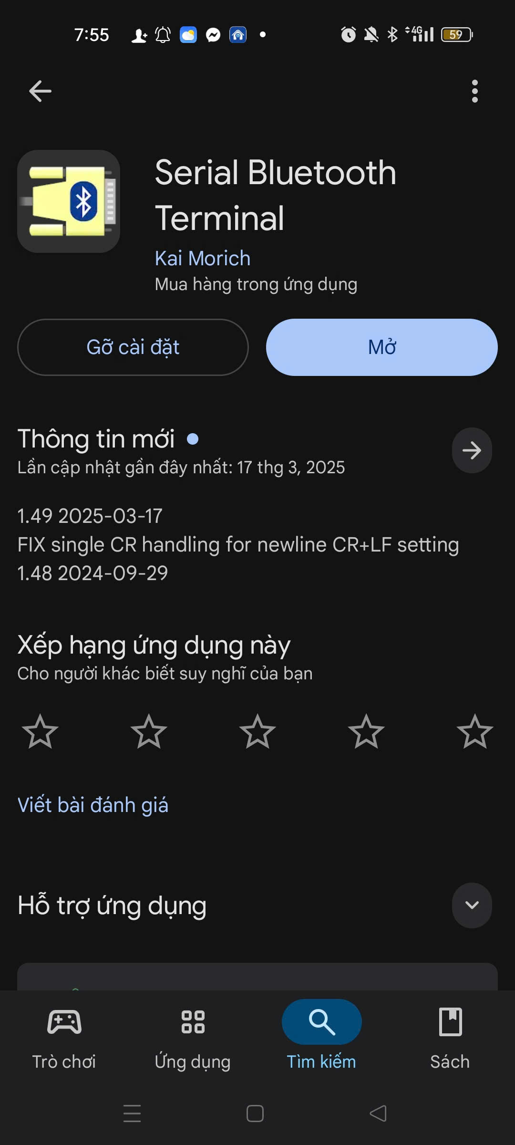
SOFTWARE PROGRAMMING
📱 Application Overview
📶 AnSupportsdroid app for Bluetooth Classic (HC-05, HC-06) and BLE communication
🔗 Serial Port Profile (SPP) with UUID 00001101-0000-1000-8000-00805F9B34FB
🌟 Key Features
💬 Simple terminal for sending/receiving text or ASCII data
⚙️ Configurable connection settings (baud rate, parity, etc.)
🧩 Macros for frequent commands
🗂️ Data logging and ASCII support
🆓 Free & Open-source – GitHub: SimpleBluetoothTerminal
🔌 Use in IoT with HC-05
📡 Connects to HC-05 via Bluetooth Classic for:
🖲️ Device control (e.g., turning relays on/off)
🌡️ Sensor data monitoring
🤖 Ideal for Arduino-based projects and embedded systems

Slide 25
SOFTWARE PROGRAMMING
✅ Pros
🔌 High compatibility with HC-05, easy setup (default baud rate: 9600).
🆓 Free, open-source, and supports data logging/macros.
📡 Reliable for simple IoT applications (e.g., device control, data collection).
❌ Cons
⏸️ Lacks pause button for data display.
🧾 Basic terminal UI, not ideal for non-technical users.
📄 Limited documentation for advanced customization.
💡 Recommendations
⏯️ Add pause button and button-based UI for commands.
📱 Improve compatibility with older Android versions.
📘 Enhance documentation for IoT integration.

Slide 26
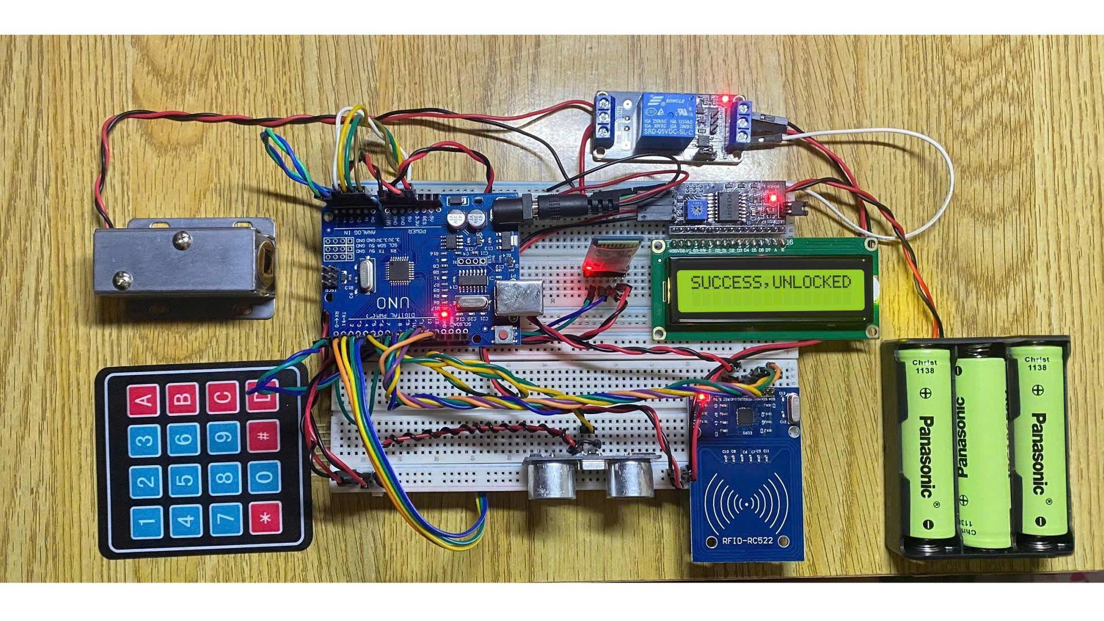

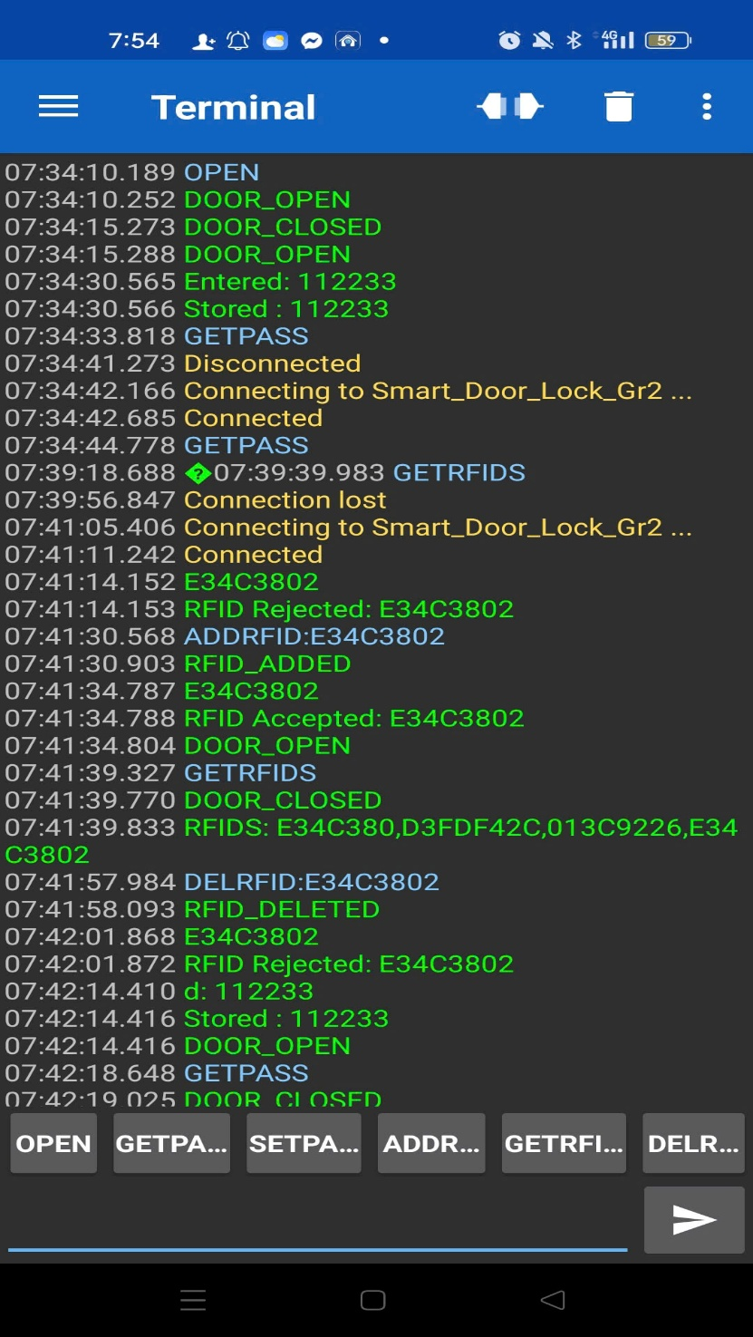

SOFTWARE PROGRAMMING

Slide 27
PROGRAMMING
FLOWCHART

Slide 28
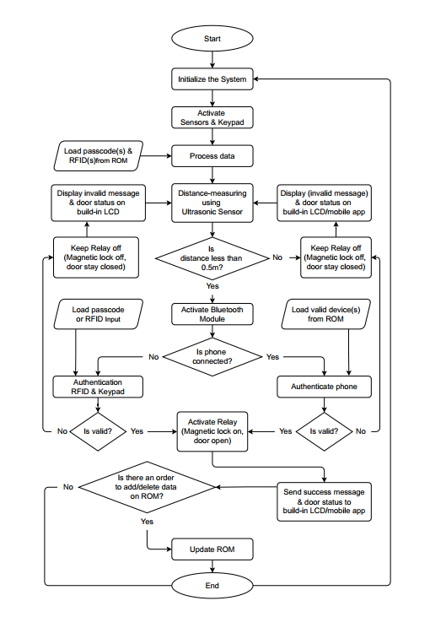
FLOWCHART
✅ Initialization Phase
MCU (Arduino/ESP8266) sets up ultrasonic sensor, RFID, keypad, Bluetooth, and memory.
🔍 Presence Detection
Ultrasonic sensor checks if a user is within 0.5m range.
If no user: remain idle, door locked.
If yes: activate Bluetooth, allow input.
🔐 Authentication Options
Enter PIN via keypad
Scan RFID card
Connect via smartphone (Bluetooth ID)

Slide 29
FLOWCHART
⚙️ Credential Verification
If match found:
✅ Unlock door (relay activates magnetic lock)
📟 Show success message on LCD/app
If not:
❌ Stay locked, show error, reset to idle
🛠️ Credential Management
Admin can add/remove RFID or PINs via secure ROM update mode.
🔋 Power Efficiency
Modules like Bluetooth and relay only turn on when needed to save power.

Slide 30
CONCLUSION

Slide 31
CONCLUSION
✅ Multi-layer Authentication:
Uses ultrasonic sensor, RFID, keypad, and Bluetooth for secure access.
🧠 Central Controller:
Arduino Uno handles input processing and access verification.
🔋 Power Efficiency:
Activates Bluetooth and relay only upon user presence.
📱 Mobile App Integration:
Supports remote unlock and real-time monitoring.
🔄 Flexible Management:
Allows credential updates (PIN/RFID) by authorized users.
🔧 Modular & Expandable:
Ready for upgrades (e.g., fingerprint, camera, cloud logging).
🏡Use Cases:
Suitable for smart homes and office security.

Slide 32

THANK YOU
FOR LISTENING

